Slide 1
Richa Singh
IBM-No-Attrition-DataSet
12-03-2018

Slide 2
Dataset
The IBM-No-Attrition Dataset consists of: 1233 Observations and 32 variables
Research Question: How do all 1233 HR-IBM Employees differ on the variables like Monthly Income vs Department ? Job Role vs MonthlyIncome ? etc. Explore important questions such as ‘show the breakdown of business travel by job role’ or ‘compare average monthly income by education’. This is a fictional data set created by IBM data scientists.
Quantitative Variables
Age, Monthly Income, Daily Rate, Hourly Rate, MonthlyRate, Distance From Home, PercentSalaryHike, TotalWorkingYears, TrainingTimesLastYear, WorkLifeBalance, WorkLifeBalance, YearsAtCompany, YearsInCurrentRole, YearsSinceLastPromotion, Years With Curr Manager
Ordinal Variables
Age,Performance Rating, Education, JobInvolvement, Job Level, StockOption Level, Environment Satisfaction, Job Satisfaction , Relationship Satisfaction
Qualitative Variables
Attrition, Business Travel, Education Field, Gender, Jon Role, Marital Status,Over Time

Slide 3
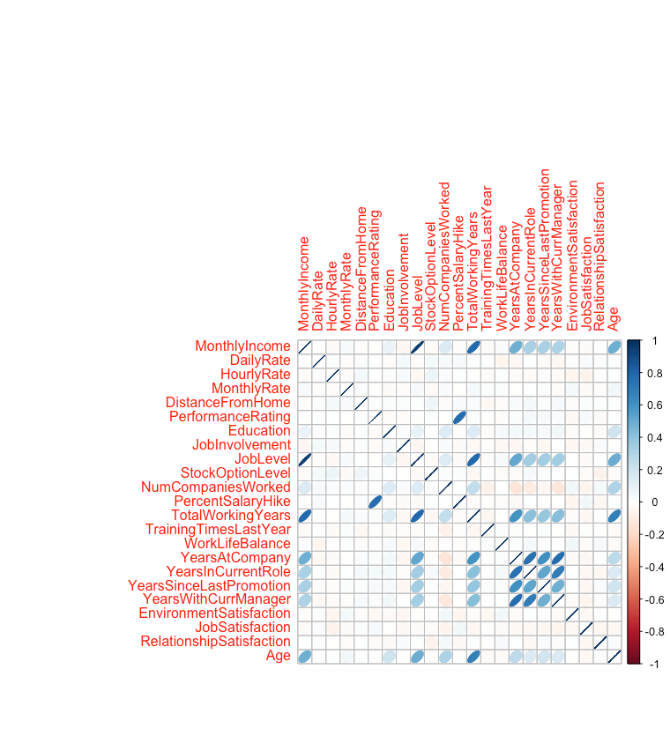
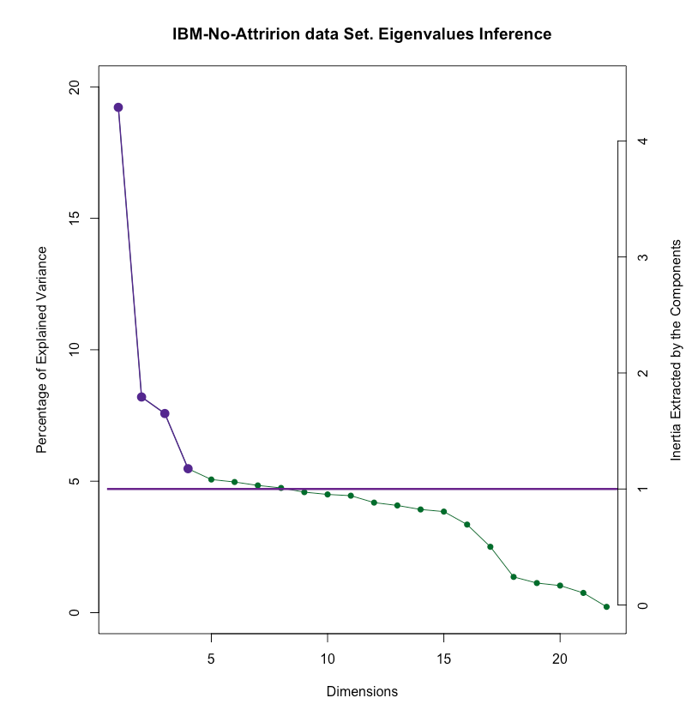
PCA
Analysis of dependent Quantitative Variables matrix X which is decomposed via SVD.The second matrix is a diagonal matrix that stores the Singular Values, which are the square-root of eigenvalues.
Correlation Plot
Scree Plot

Slide 4
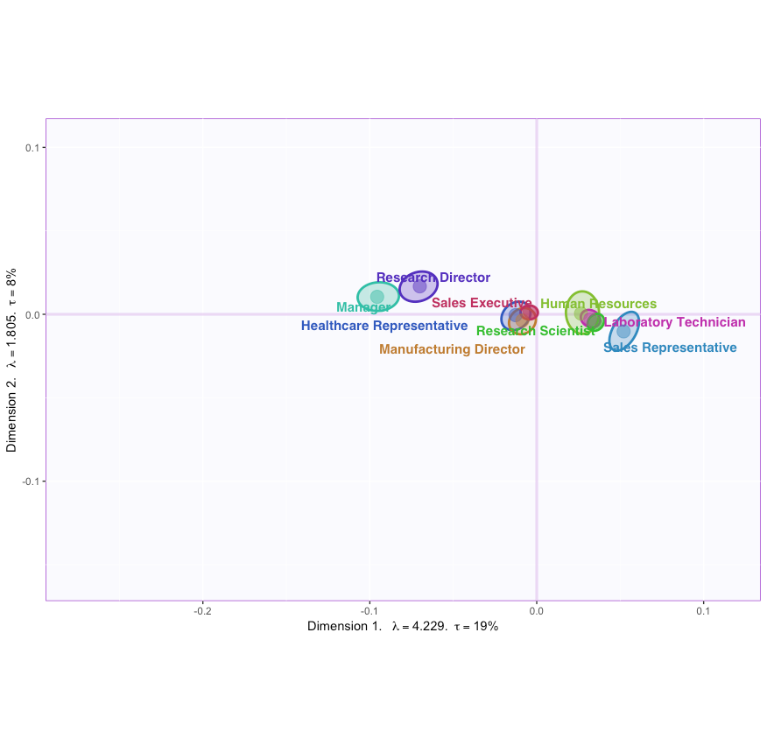
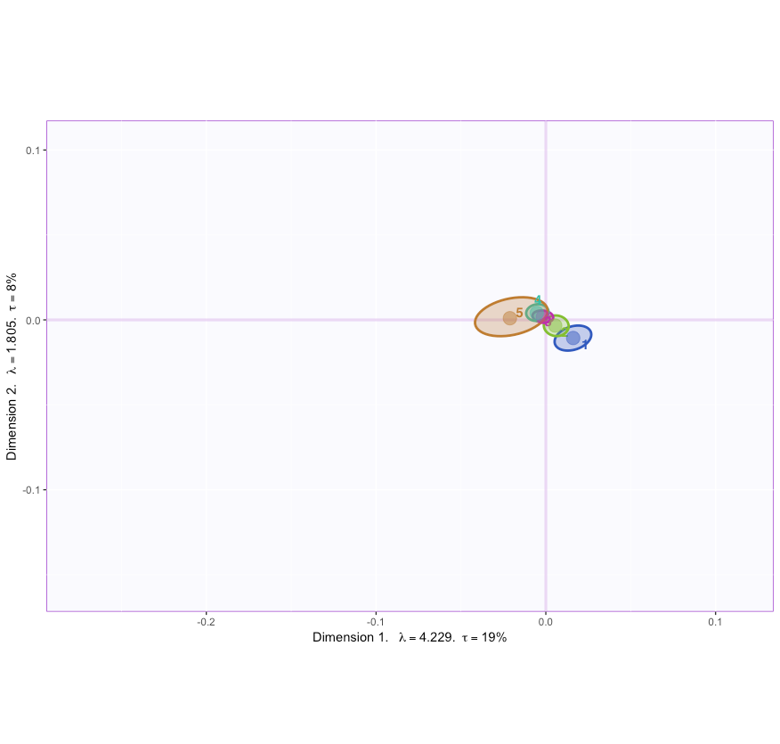
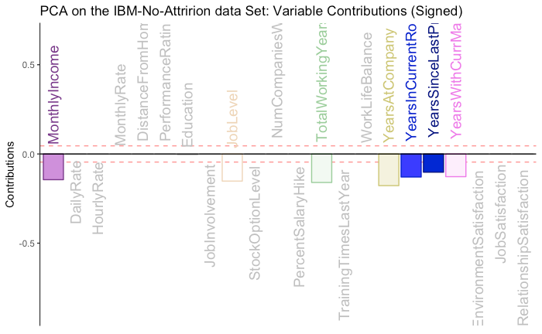
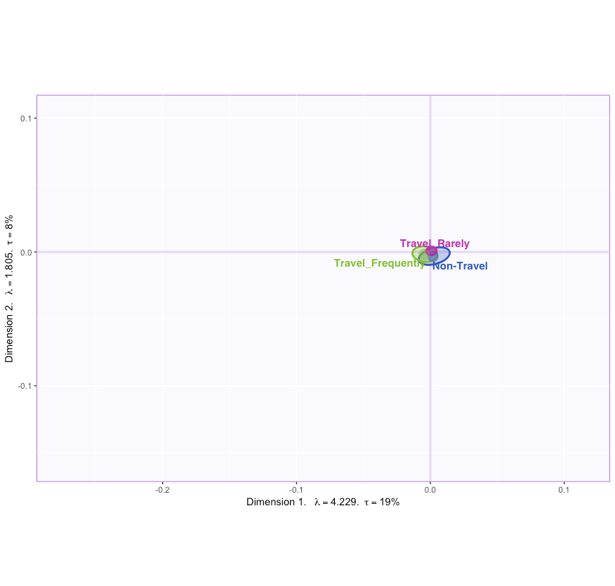
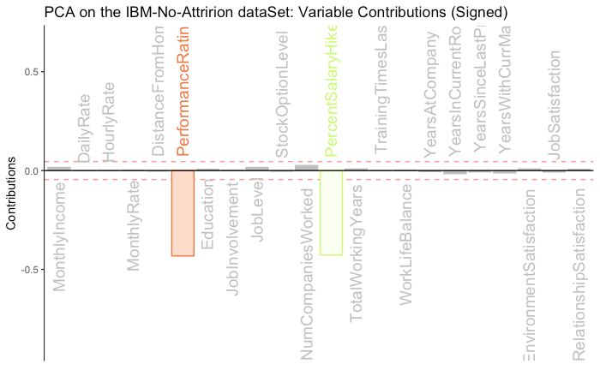
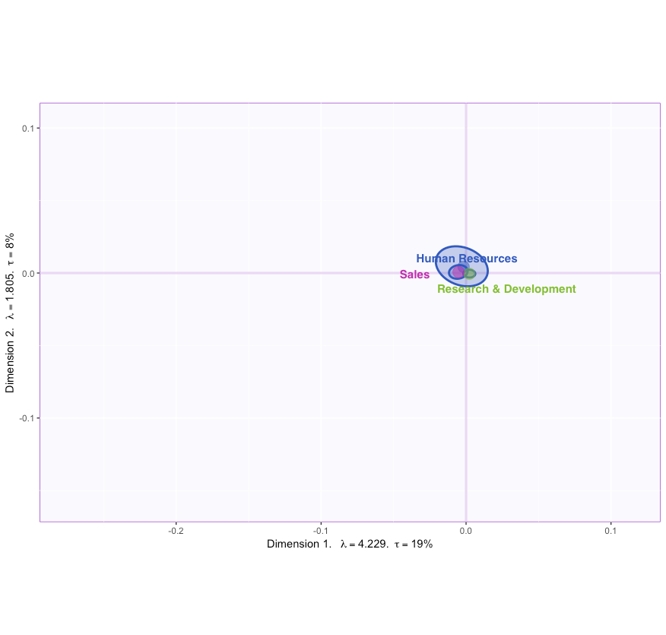
PCA: C.I for Mean & Loadings
Job-Role
Education
Contributions-1st Component
Contributions-2nd Component
Business Travel
Department-Type

Slide 5
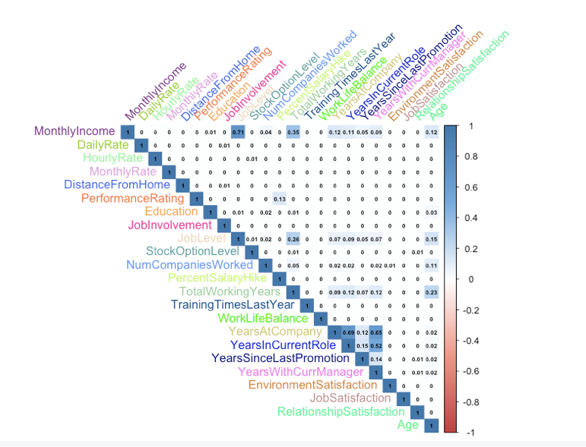
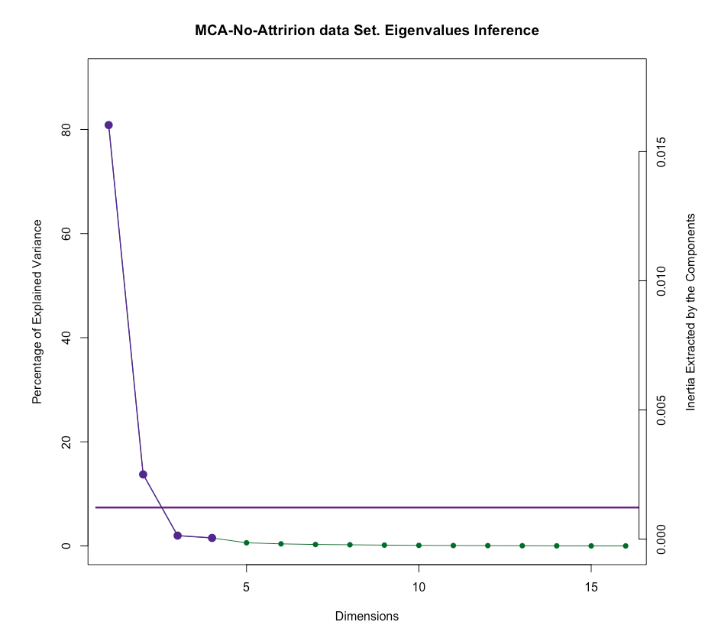
MCA
Qualitative Variables . The data table that goes in MCA is an indicator matrix which is disjunctively coded.
Heat-Map
Scree-Plot

Slide 6
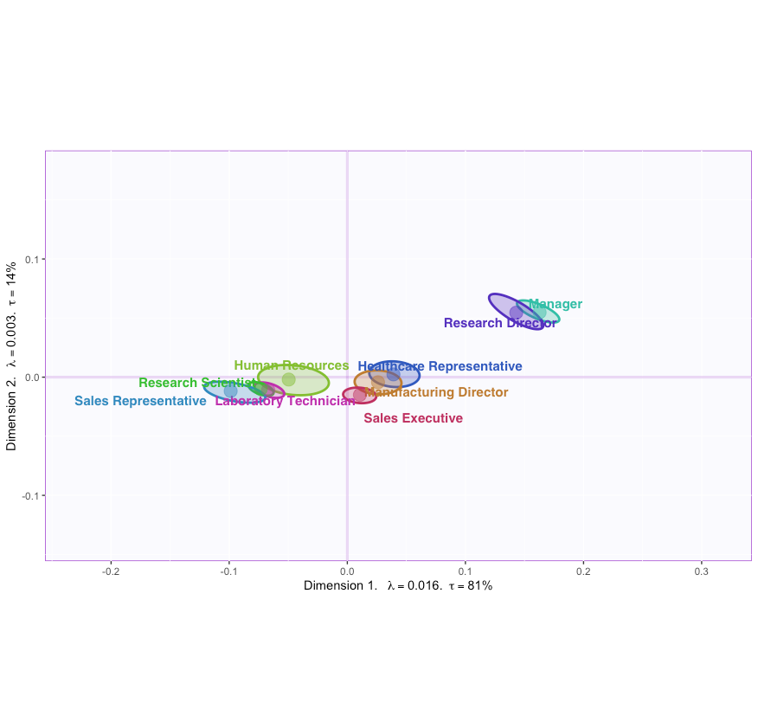
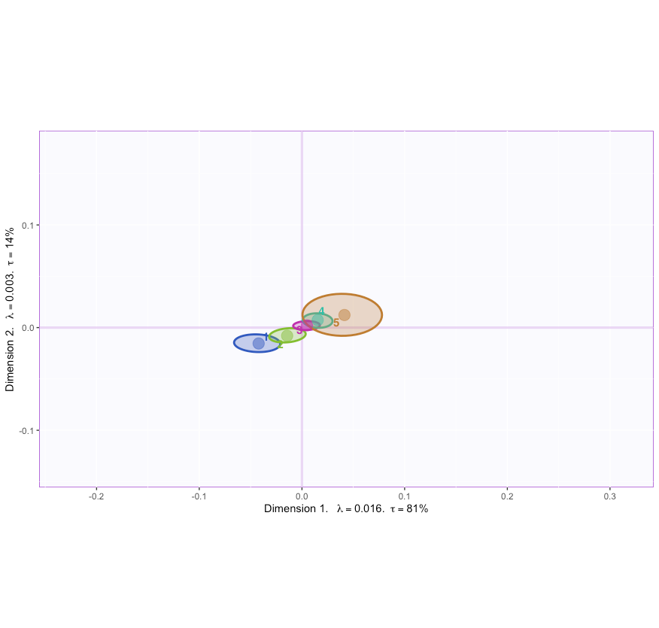
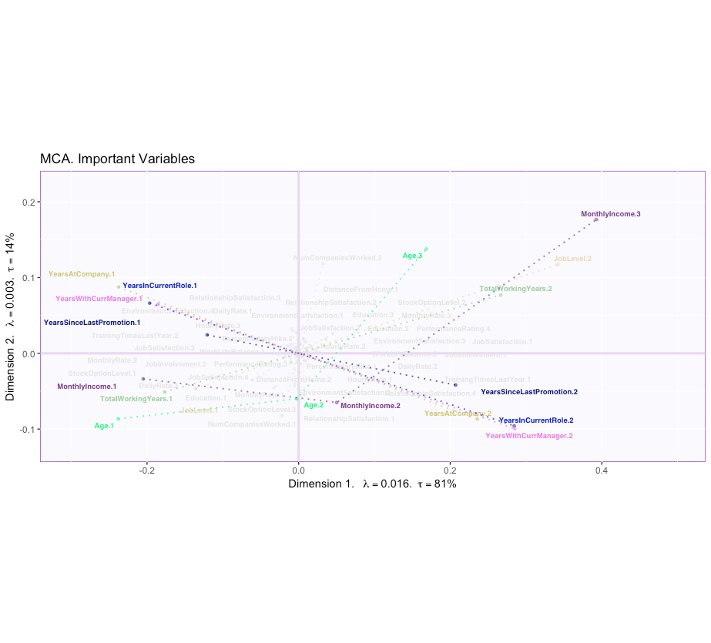
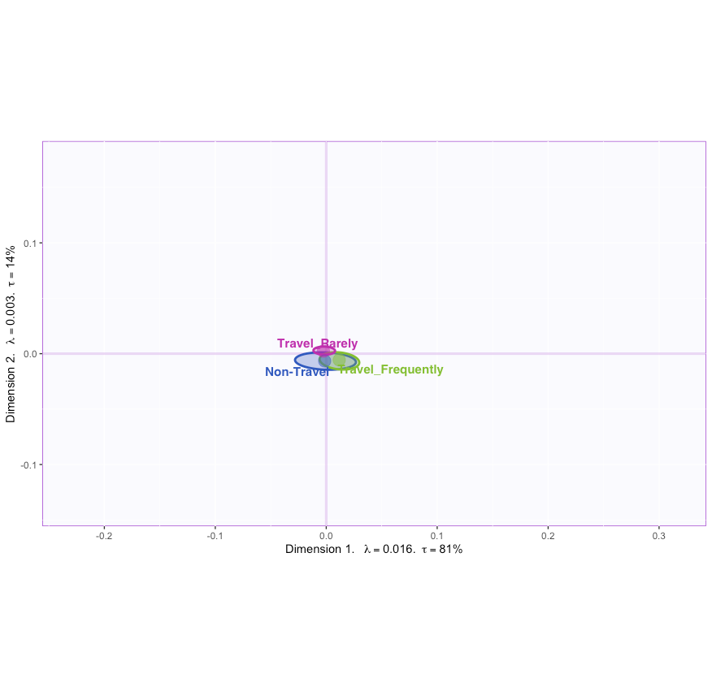
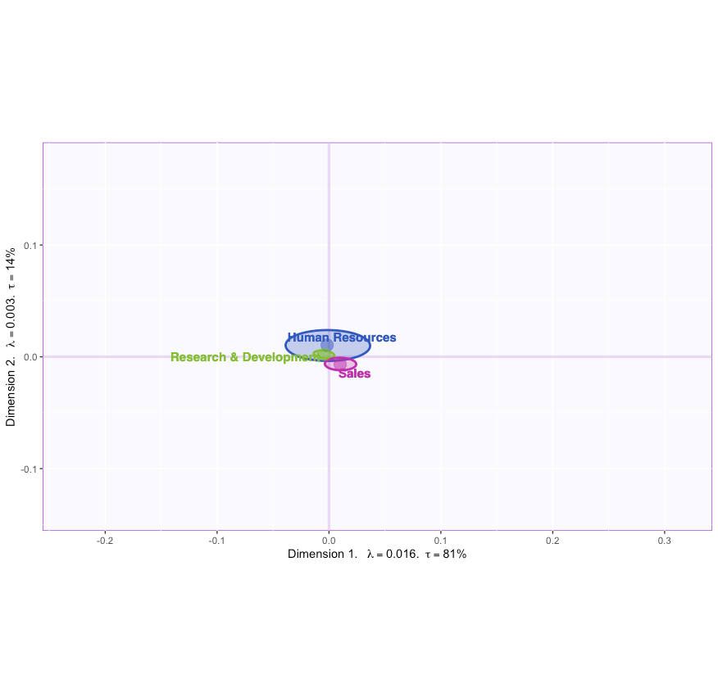
MCA: C.I for Mean & Loadings
Job-Role
Education
Important Variables
Business-Travel
Department-Type

Slide 7
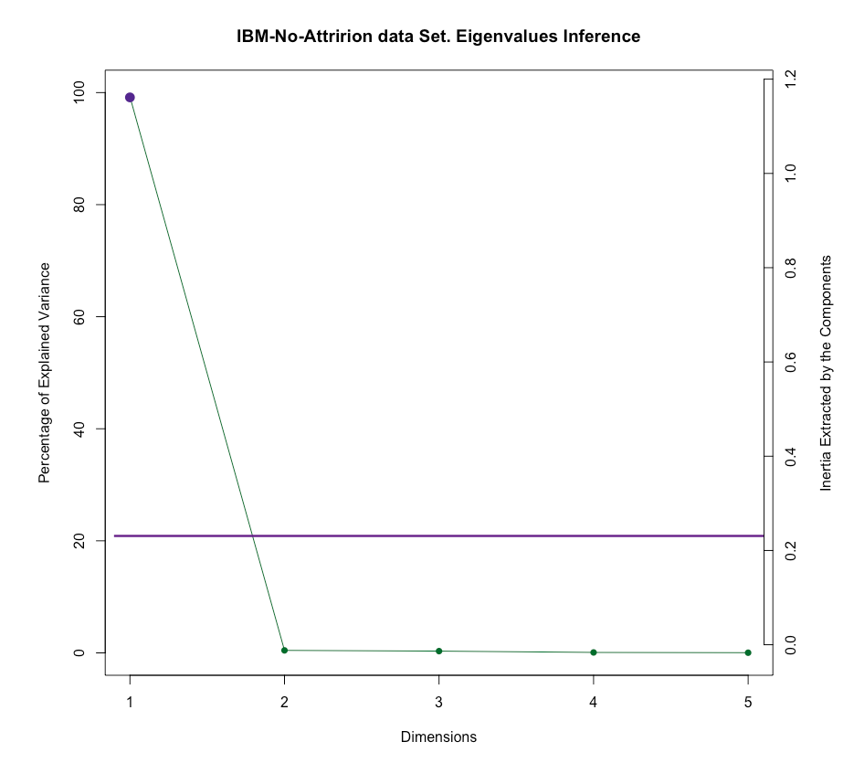
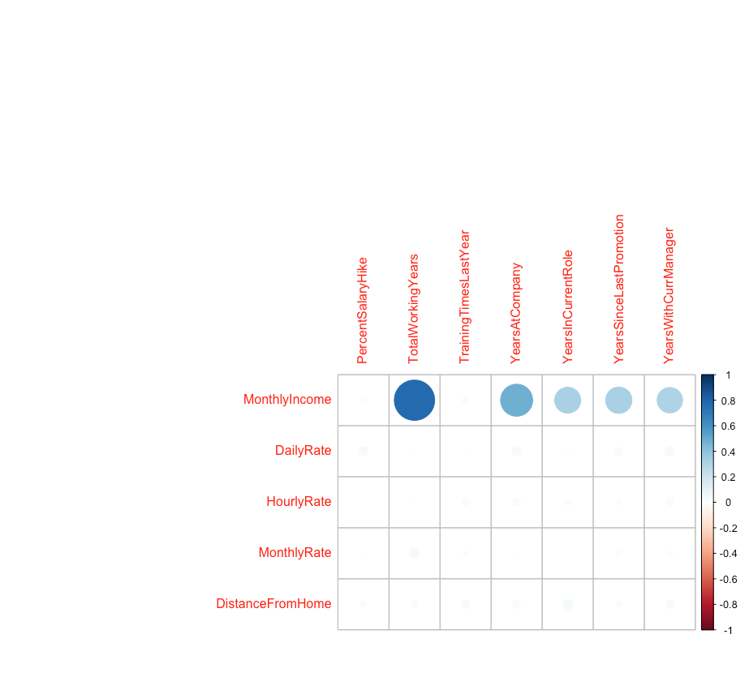
PLS-C
Scree-Plot
DATA
Table 2
Table 1
PercentSalaryHike,TotalWorkingYears, TrainingTimesLastYear, WorkLifeBalance, YearsAtCompany,YearsInCurrentRole, YearsSinceLastPromotion, Years With Curr Manager
MonthlyIncome, DailyRate, HourlyRate, MonthlyRate, DistanceFromHome
Correlation-Plot
Finds components that maximises the covariance between 2 latent variables computed on 2 quantitative matrices

Slide 8
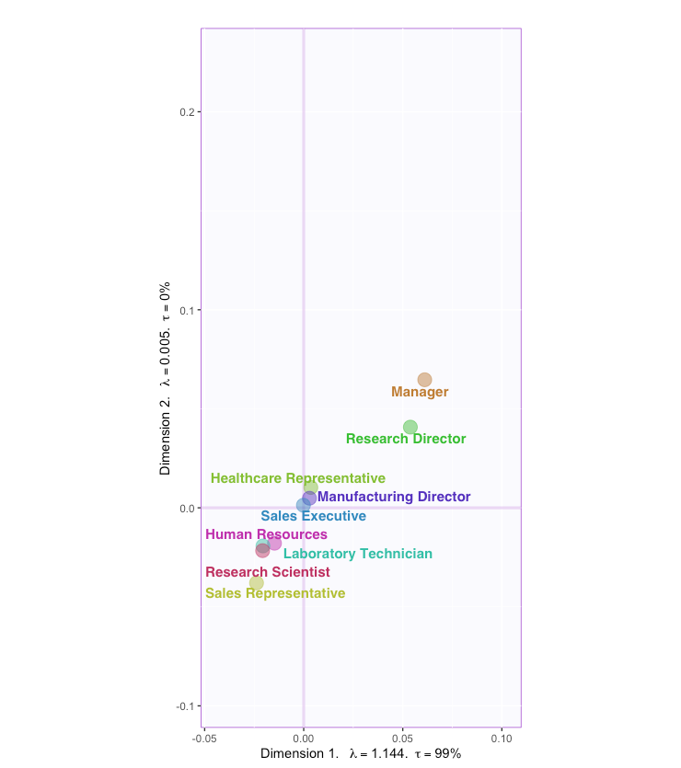
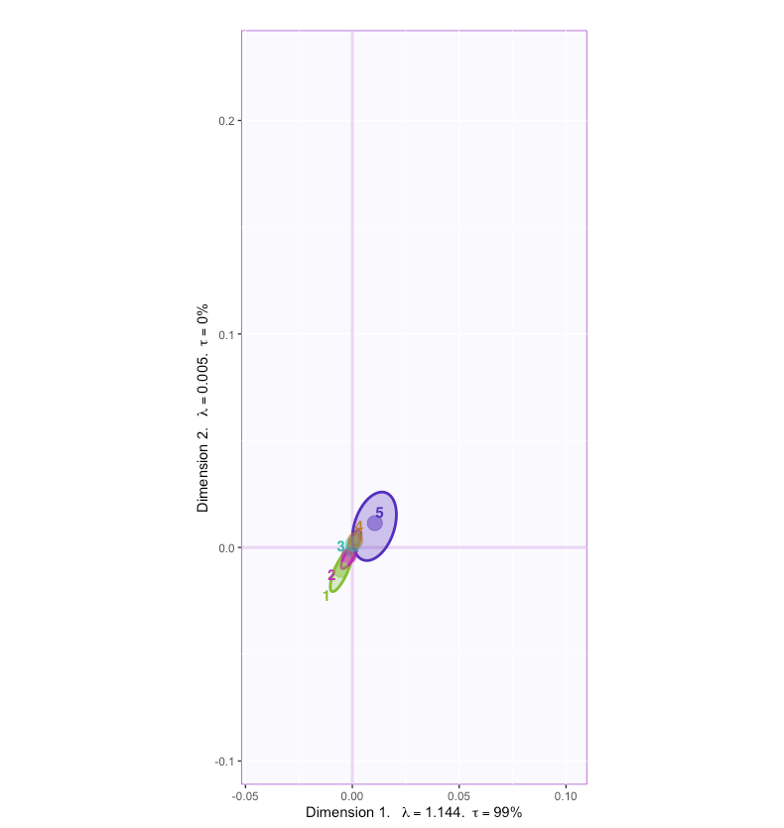
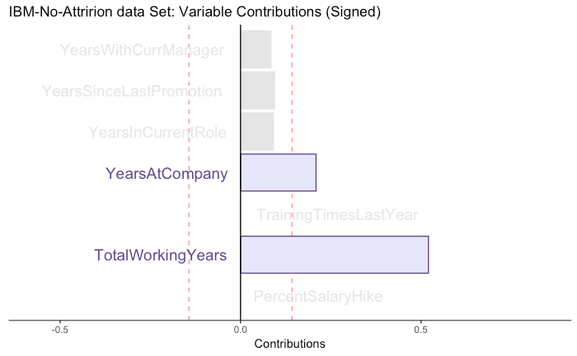
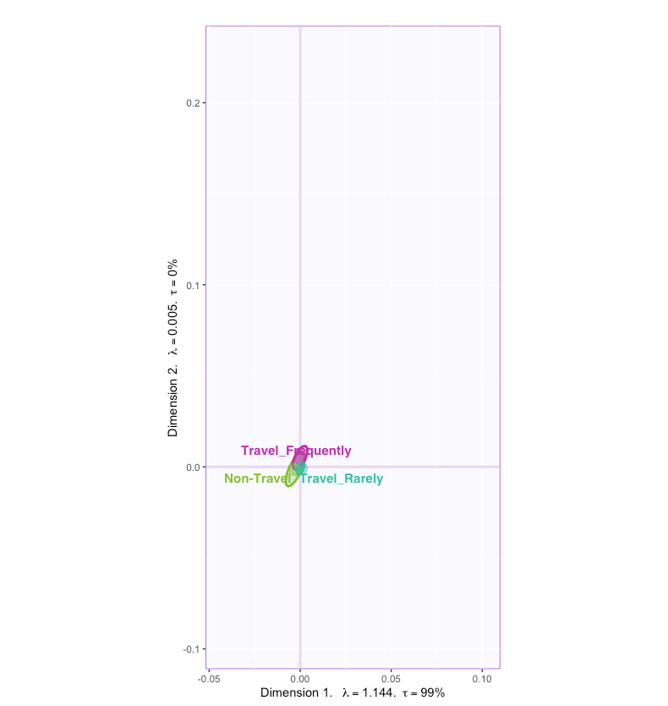
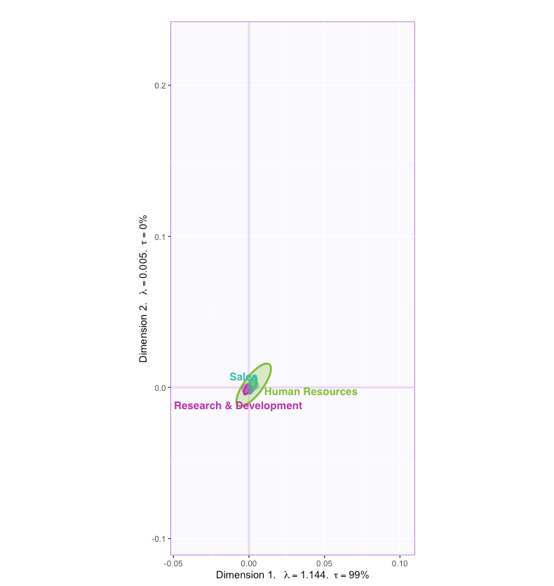
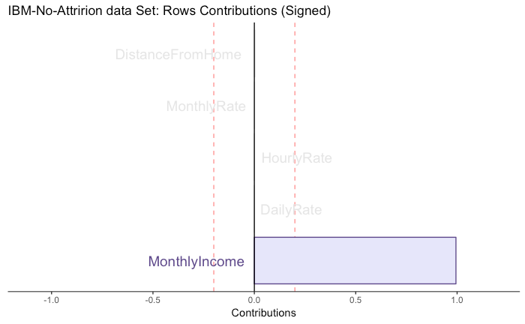
PLS-C: C.I for Mean & Loadings
Job-Role
Education
Contributions: Important Variables
Contributions: Important Rows
Business-Travel
Department-Type

Slide 9
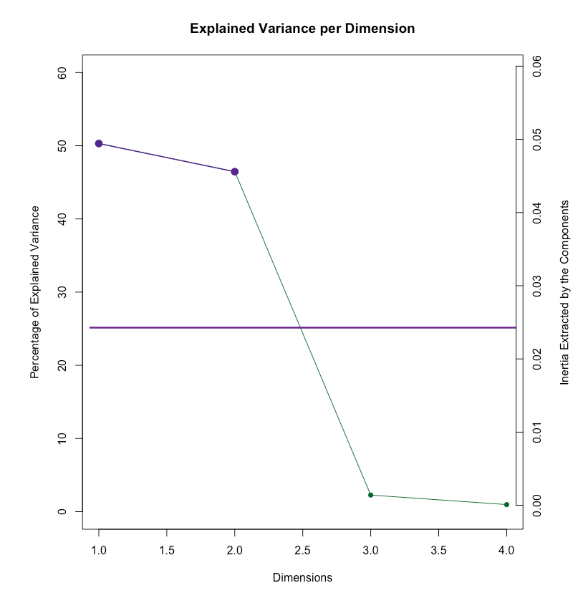
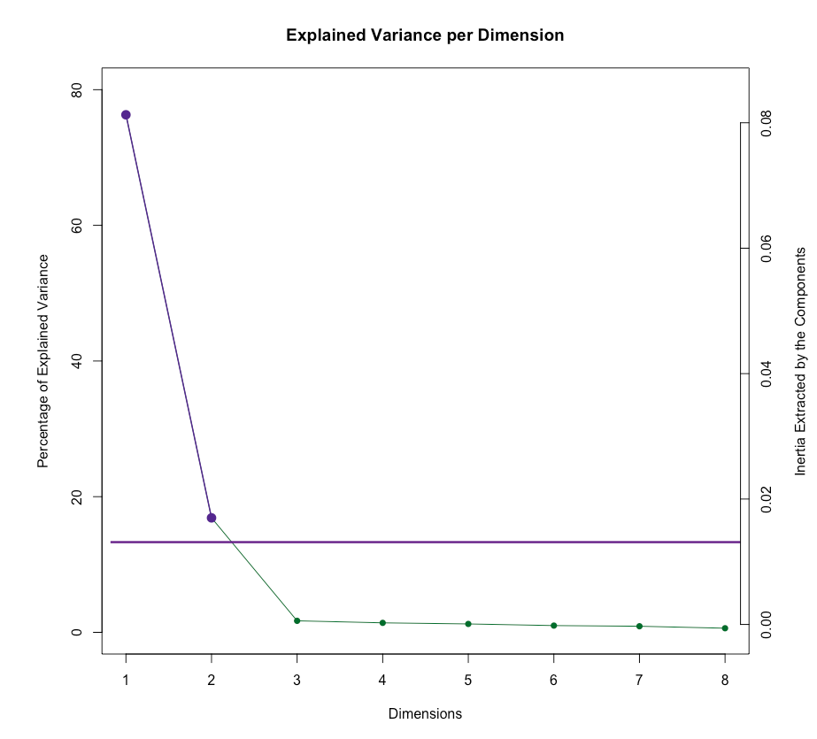
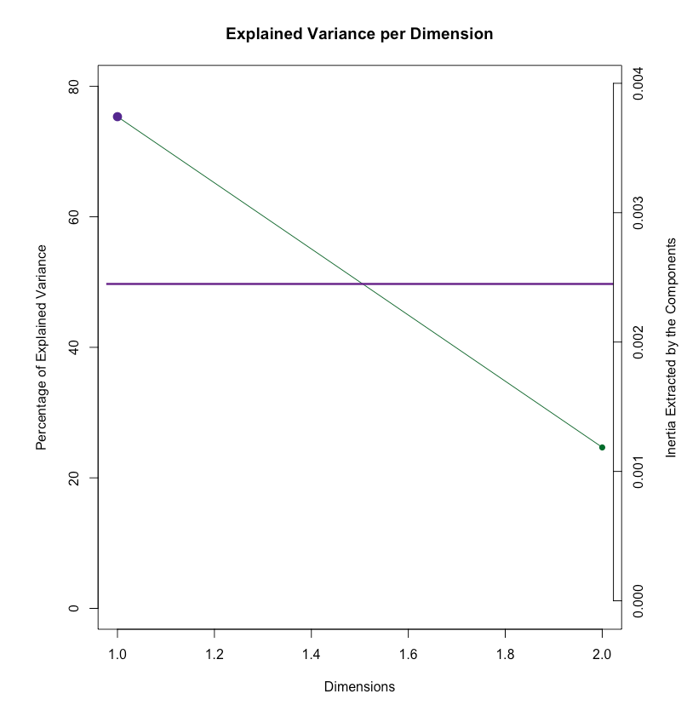
DiCA
Scree-Plot : Job-Role
Scree-Plot : Education
DiCA represents each group by the sum of its observations and performs a simple CA on the groups by variables matrix.
Scree-Plot : Business Travel
Scree-Plot : Department-Type

Slide 10
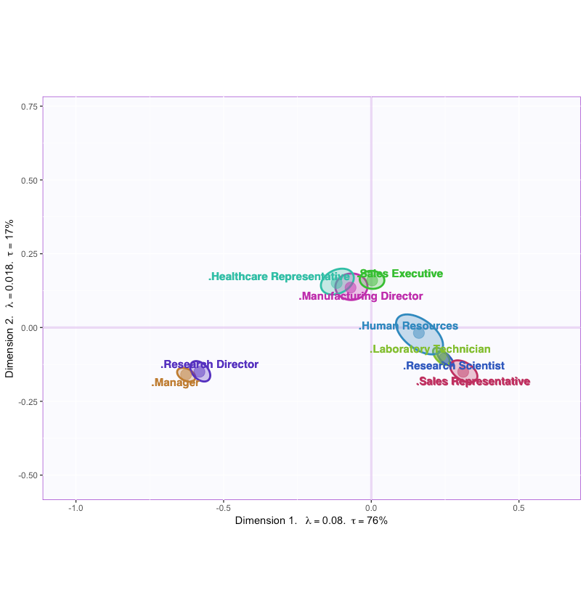
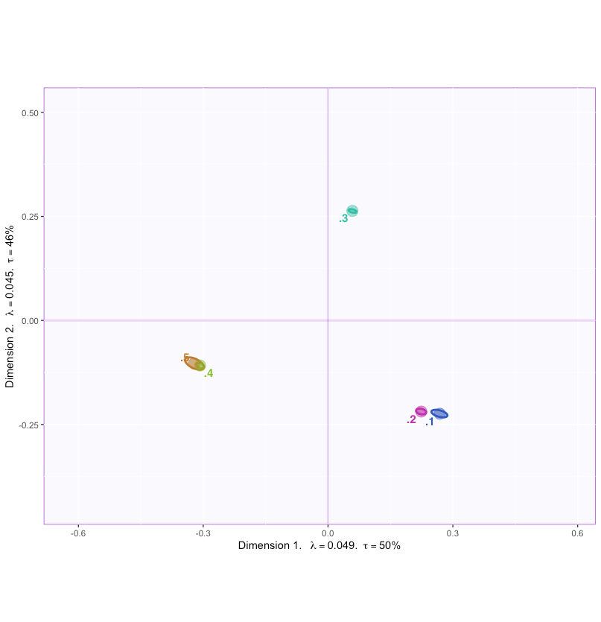
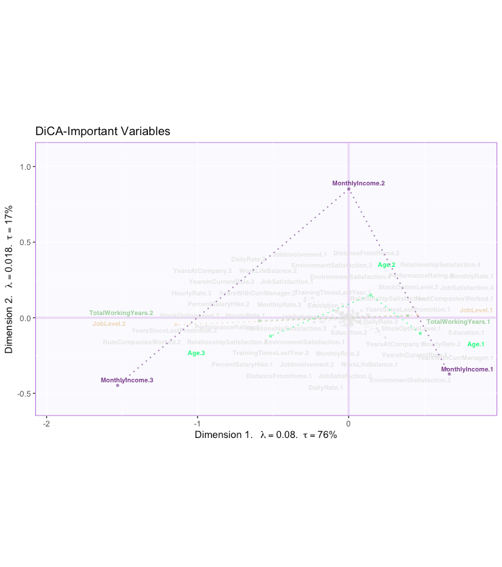
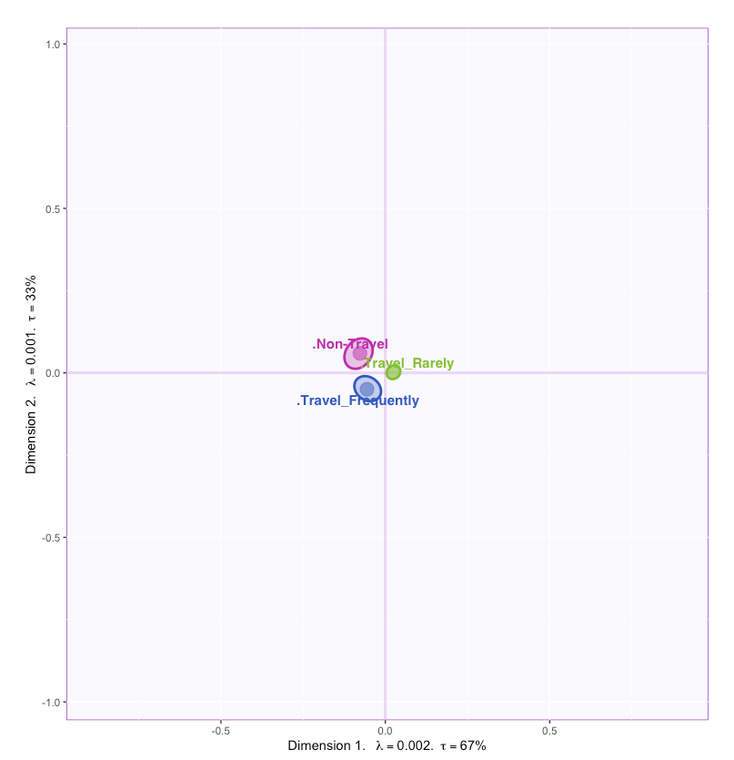
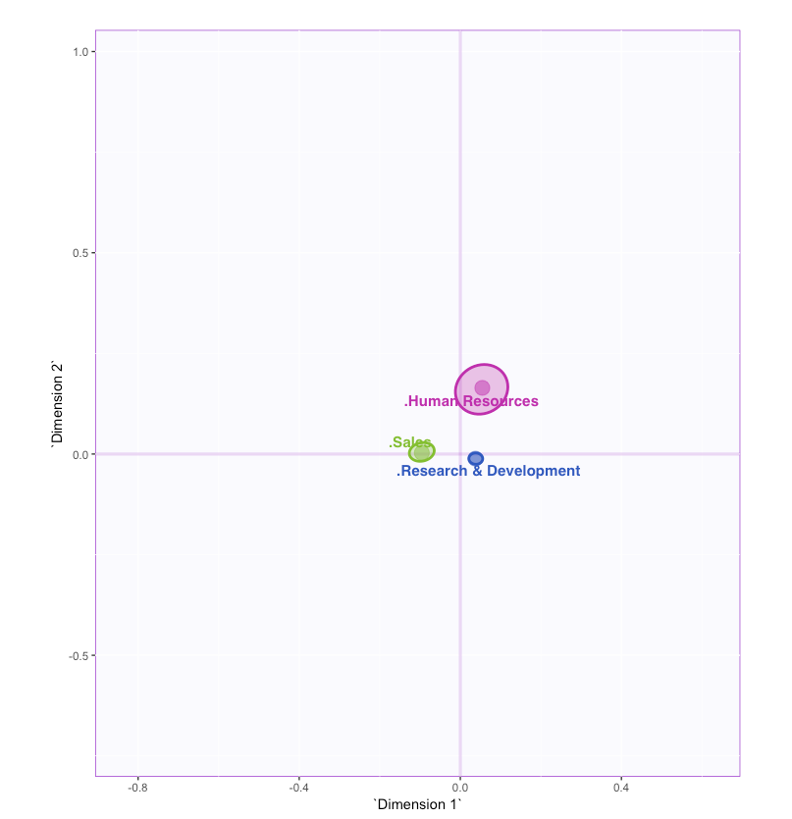
DiCA: C.I for Mean & Loadings
Job-Role
Education
Important Variables
Business-Travel
Department-Type

Slide 11
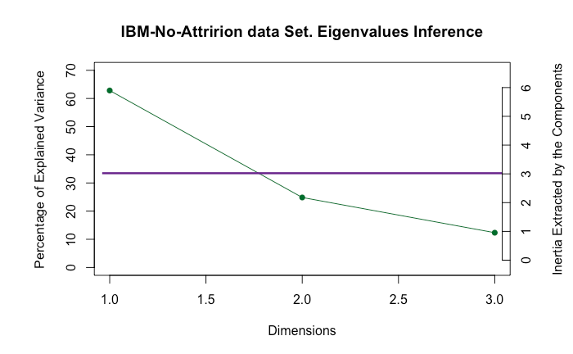
MFA
Scree-Plot
DATA
Table 1
Table 3
TotalWorkingYears, TrainingTimesLastYear, WorkLifeBalance, YearsAtCompany,YearsInCurrentRole, YearsSinceLastPromotion, YearsWithCurrManager
MonthlyIncome, DailyRate, HourlyRate, MonthlyRate, DistanceFromHome
Table 2
PerformanceRating, Education, JobInvolvement,JobLevel, StockOptionLevel, NumCompaniesWorked,PercentSalaryHike

Slide 12
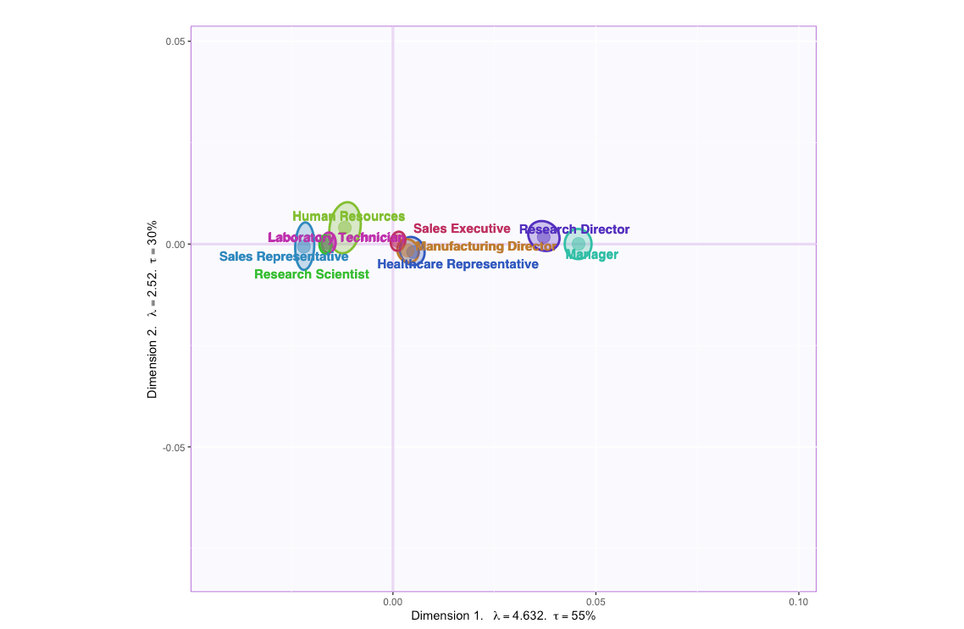
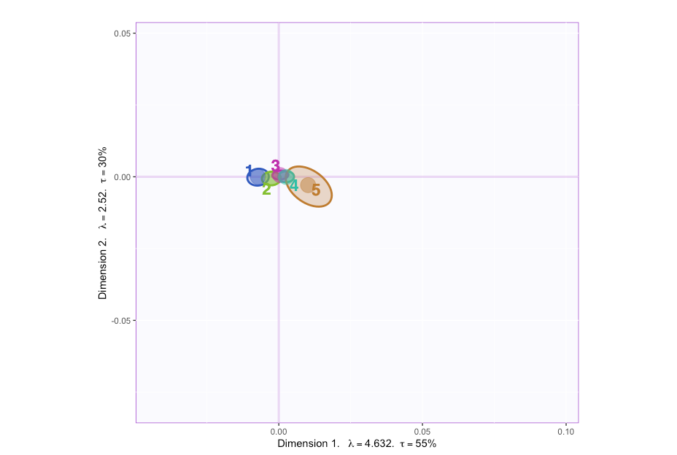
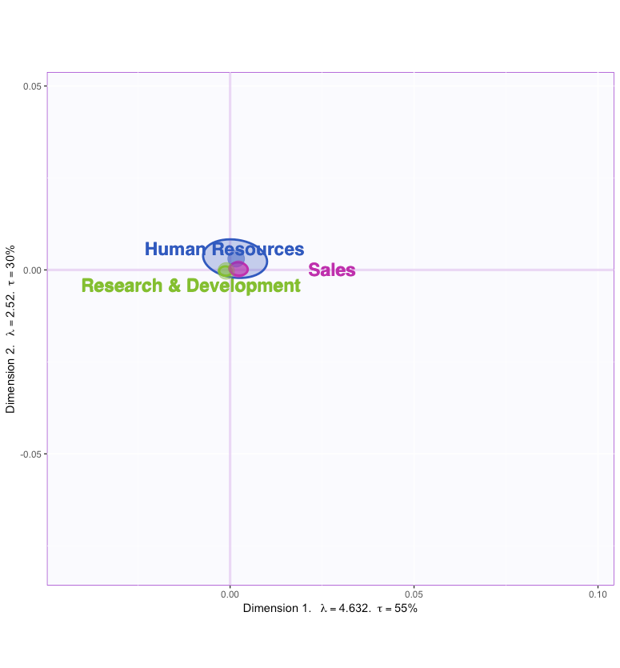
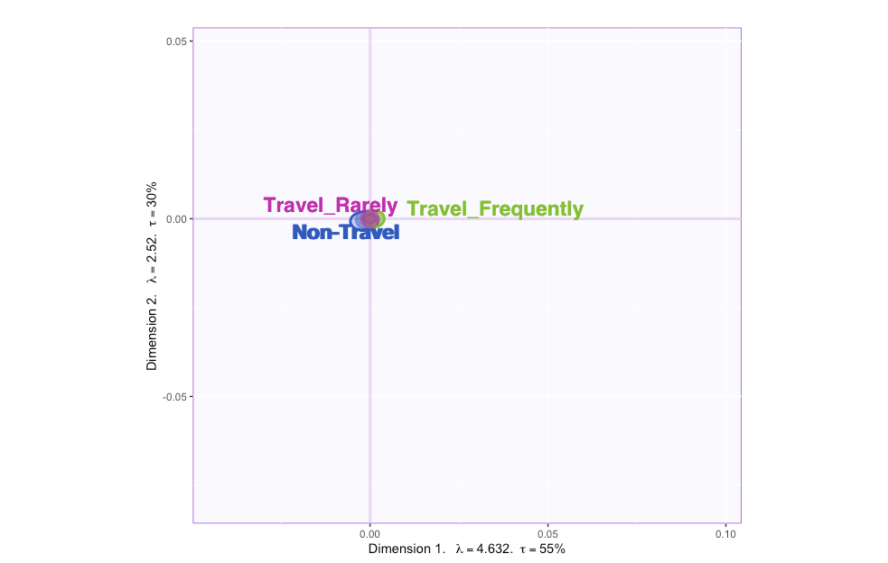
MFA: C.I for Mean
Job-Role
Education
Business-Travel
Department-Type

Slide 13
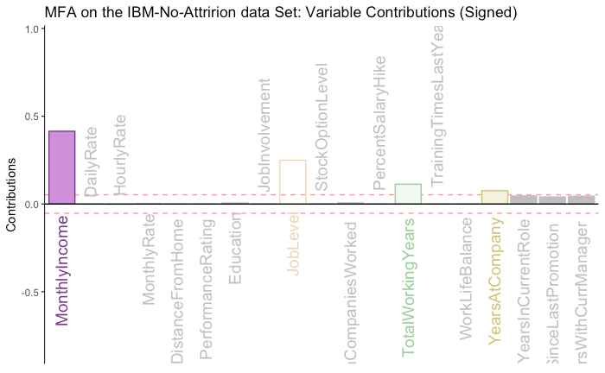
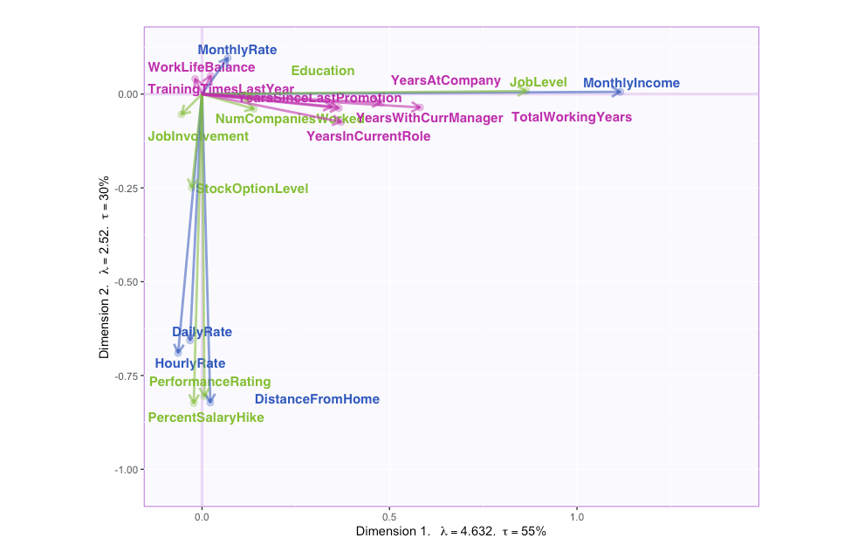
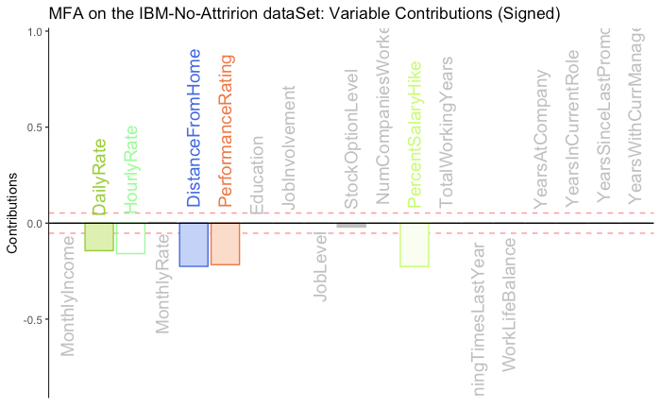
MFA: Loadings & Contributions
Contributions-1st Component
Loadings-1st Component & 2nd Component
Contributions-2nd Component

Slide 14
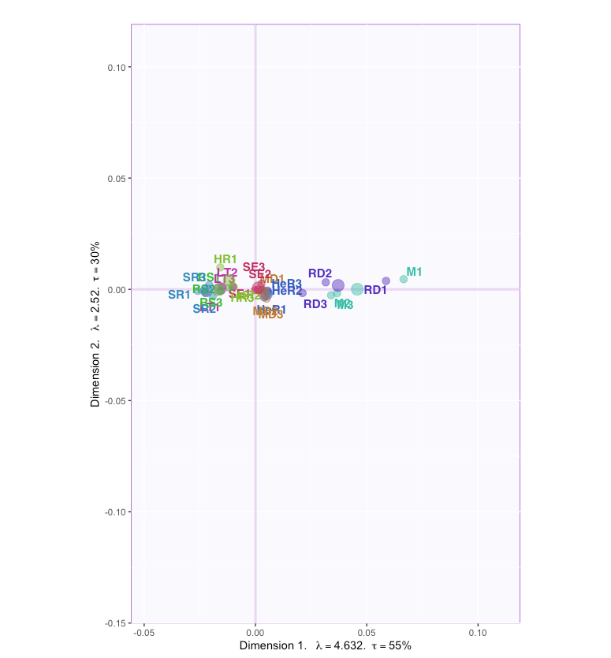
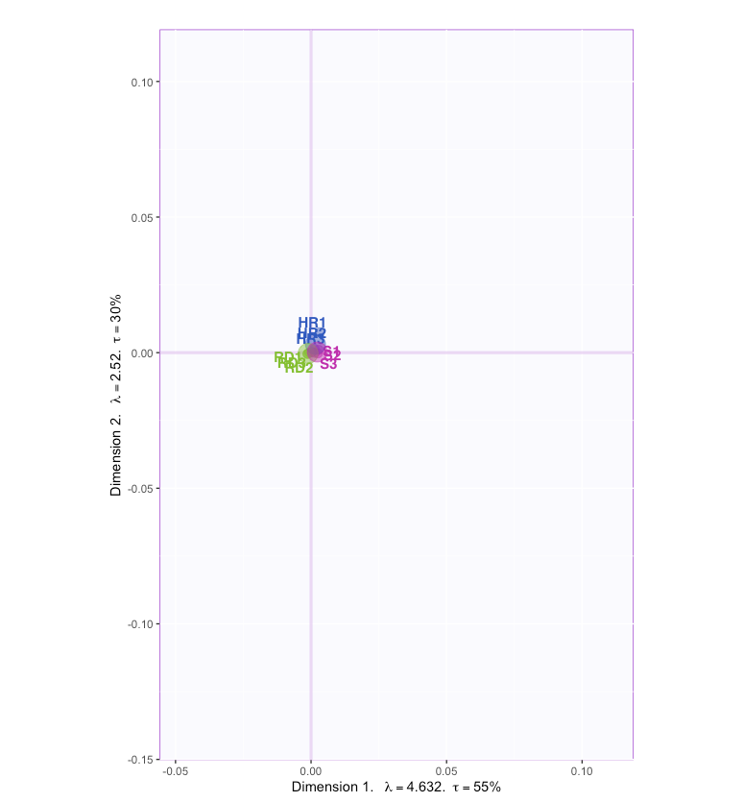
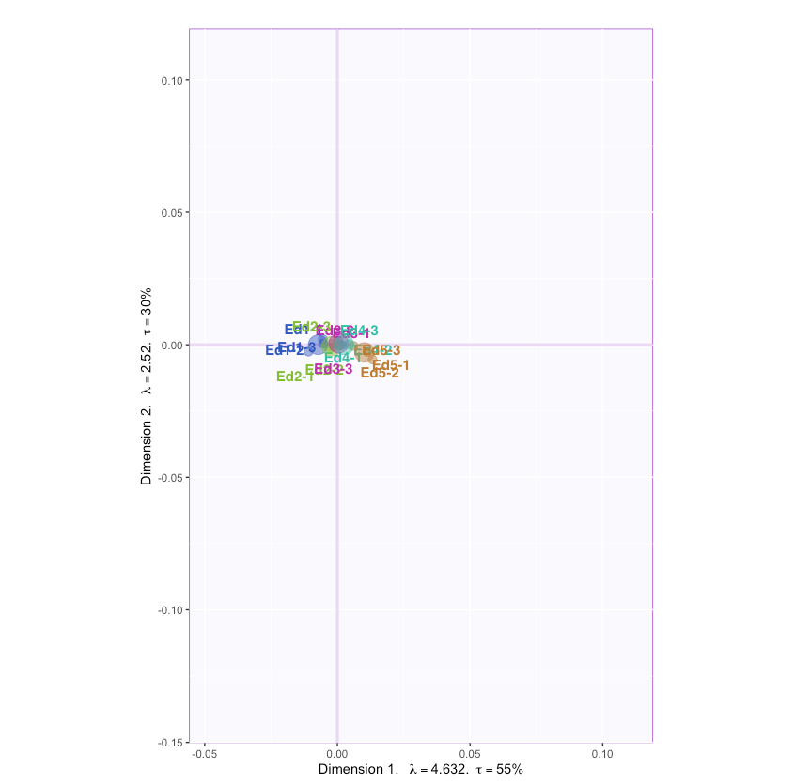
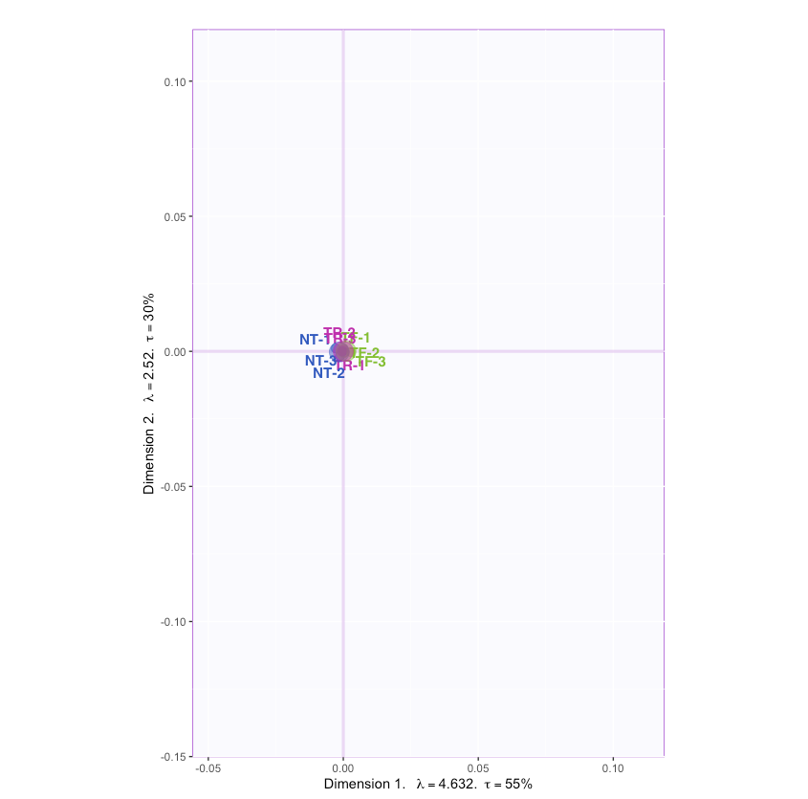
Partial Factor Scores
Job-Role
Education
Business-Travel
Department-Type

Slide 15
Conclusion
People who are Managers and Research Directors have the highest pay and are more seasoned while people who are Sales representative and Lab Technician have low pay and less experience
Generally, Managers and Directors are the ones with PhD & Master’s with higher job level, Sales representative and Lab Technician have no college education while Healthcare Representatives & Manufacturing Directors have Bachelor’s degree
It is also observed that the Mangers and Research Directors travel the most, could their meetings and conferences while the HR, Sales representative,Lab Technician, Research Scientists travel occasionally
Also, from the Partial factor score plot we can see that the first table drives the mean Fi for both the Managers and the Research Directors also we can say that people from diverse backgrounds can be Managers & Research Directors
No significant inference could be observed in the Department type domain

Slide 16
Questions or comments?

